Slide 1

Accounting

Slide 2

Accounting
Accounting is the systematic process of recording, summarizing, analyzing, and interpreting financial transactions and activities of an organization. It involves capturing financial information related to transactions, assets, liabilities, income, and expenses in a structured manner to provide a clear and accurate picture of the organization's financial health and performance. Accounting facilitates informed decision-making, financial reporting, compliance with regulations, and communication of financial information to stakeholders.

Slide 3
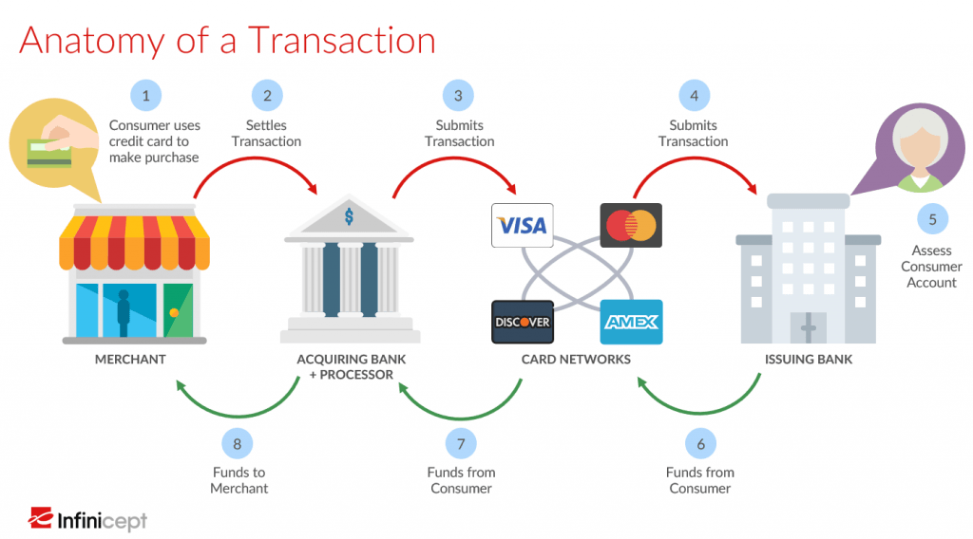
Anatomy Of A Transaction

Slide 4
Types Of Accounting
In the payment card industry, various types of accounting practices are employed to manage the complex financial transactions and activities associated with payment processing.
Interchange Accounting
Customer Account Accounting
Merchant Accounting
Acquirer and Issuer Accounting
Reconciliation and Settlement
Chargeback Accounting
Fraud and Risk Management Accounting
Revenue Recognition
Dispute Management

Slide 5
Types Of Accounting
Interchange Accounting
Interchange fees are paid between acquiring banks and issuing banks for processing card transactions. Accounting for interchange fees involves tracking the fees associated with different card networks and ensuring accurate settlement between banks.
Customer Account Accounting
After getting authorization request, issuer bank check the fund of customer’s account for purchase or withdraw. If fund available issuer bank debit the customer account with necessary fees . If it is account funding transaction, issuer credit the customer’s account.

Slide 6
Types Of Accounting
Interchange Accounting
Interchange fees are paid between acquiring banks and issuing banks for processing card transactions. Accounting for interchange fees involves tracking the fees associated with different card networks and ensuring accurate settlement between banks.
Customer Account Accounting
After getting authorization request, issuer bank check the fund of customer’s account for purchase or withdraw. If fund available issuer bank debit the customer account with necessary fees . If it is account funding transaction, issuer credit the customer’s account.

Slide 7
Example Of Accounting - Merchant Accounting
Transaction Recording
Sending transactions as a Batch
Settlement: Process settlement of funds from the acquiring bank to the merchant. Settlement involves transferring the net amount after deducting interchange fees, processing fees, and any chargebacks.
Reconciliation: Regularly reconcile merchant accounts to ensure accuracy and identify any discrepancies between recorded transactions and settled funds.
Chargeback Management
Reserve Accounts: Some acquiring banks may require merchants to maintain reserve accounts as a security measure against potential chargebacks or fraud. Accounting for these reserve accounts is essential.
Accounting file process

Slide 8
Reconciliation

Slide 9

Introduction To Reconciliation
Reconciliation is an accounting procedure that compares two sets of records to check that the figures are correct and in agreement. Reconciliation also confirms that accounts in a general ledger are consistent and complete. Reconciliation can be used for personal as well as business purposes.

Slide 10
The importance of reconciliations
• Reconciliation allows organizations to proactively identify and resolve issues.
• Simply isolating differences is not enough to consider two sets of records “reconciled.”
• Errors identified in the reconciliation process should be thoroughly investigated and corrected.
Companies use reconciliation to prevent balance sheet errors on their financial accounts, check for fraud, and make sure that transactions were appropriately booked to the general ledger.
In double-entry accounting, each transaction is posted as both a debit and a credit.
Individuals can also use reconciliation to check the accuracy of their bank and credit card account statements.

Slide 11
The importance of reconciliations
• Reconciliation allows organizations to proactively identify and resolve issues.
• Simply isolating differences is not enough to consider two sets of records “reconciled.”
• Errors identified in the reconciliation process should be thoroughly investigated and corrected.
Companies use reconciliation to prevent balance sheet errors on their financial accounts, check for fraud, and make sure that transactions were appropriately booked to the general ledger.
In double-entry accounting, each transaction is posted as both a debit and a credit.
Individuals can also use reconciliation to check the accuracy of their bank and credit card account statements.

Slide 12
KEY TAKEAWAYS:
Reconciliation is an accounting process that ensures that the actual amount of money spent matches the amount shown leaving an account at the end of a fiscal period.
Individuals and businesses perform reconciliation at regular intervals to check for errors or fraudulent activity.
Reconciliation is typically done at regular intervals, such as monthly or quarterly, as part of normal accounting procedures.
There are two methods of reconciliation: documentation review and analytics review.
For small businesses, the main goal of reconciling your bank statement is to ensure that the recorded balance of your business and the recorded balance of the bank match up.

Slide 13
Drawbacks of Manual Bank Reconciliation
Error-prone and time-consuming
Each transaction and its amount have to be matched, and unreconciled items should be identified manually or using spreadsheets, which makes the process extremely time-consuming and error-prone. In many cases, accountants end up with bank reconciliation statements saying cash book balance more than bank account balance or vice versa.
Inaccurate account risk assessment
Risk assessment of accounts using spreadsheets and other manual methods of reconciliations leads to inaccurate account prioritization.

Slide 14
Drawbacks of Manual Bank Reconciliation
No visibility and control
Usage of spreadsheets limits visibility and control throughout the entire bank account reconciliation process.
No standardized data documentation
A siloed approach involving spreadsheets leads several accountants to follow their own specific data documentation layouts, formats, and calculations, which further impedes the financial close.

Slide 15
Benefits of Automated Bank Reconciliation
Fast and accurate
AI-based anomaly detection enables faster financial close and accurate reconciliation of bank statements and general ledger (GL) and GL and sub-ledger, saving accountants from manual work and making the process faster and more accurate.
Proactive risk assessment
AI-powered reconciliation allows accountants to prioritize reconciliations by risk, value thresholds, and other key parameters and auto-assign reconciliations to users/user groups.

Slide 16
Benefits of Automated Bank Reconciliation
Improved visibility and control
Real-time dashboard offers visibility to all stakeholders on the status of reconciliation, dependencies, and any required action.
Standardized data documentation
Automation software for account reconciliation allows users to leverage pre-configured reconciliation templates (or create their own templates) to accelerate the reconciliation process. Transactional data analysis, computations, and document creation can be done in the same template.

Slide 17

The Different Types of Reconciliation
Bank reconciliation
Vendor reconciliation
Customer reconciliation
Business-specific reconciliation
Inter-company reconciliation

Slide 18
Bank reconciliation
Bank reconciliation or bank statement reconciliation is the process of verifying the bank balance in a business’ books of account by comparing them with the statement of account issued by its bank (called the bank reconciliation statement).
Bank reconciliation is a type of internal control used by many companies to verify the integrity of data between the bank records and their official records. Here, each and every transaction in the bank statement is compared with the company’s internal records (normally cash account) to check both records are matching.

Slide 19
Some Commonly Seen Issues That Result in Mismatches in Records
Issued cheques have not been presented to the bank or the bank has dishonored a cheque.
A banking transaction (eg. credit received, bank fees, penalties) has not yet been recorded in the entity’s books
Either the bank or the entity made an error while entering records.
Periodic bank reconciliation is important to spot missed payments and calculation mistakes. It will also help identify theft and fraud and track accounts payables and receivables. Depending on the volume of transactions, entities can choose to do bank reconciliation on a daily, weekly or monthly basis.

Slide 20
Vendor Reconciliation
Vendor reconciliation is defined as the reconciliation of accounts payable for a vendor with the statement provided by the particular vendor. Here, an entity reconciles vendor balance in its books of accounts with the balance in the books of the vendor. It ensures that there are no discrepancies or mistakes in the amount a vendor charges an entity and the goods or services the entity receives from the vendor. The steps in vendor reconciliation are:
Getting a statement of account from the vendor. The statement must have invoice-wise detail of each transaction.
Comparing the statement with the vendor accounts as per the entity’s books of account.
Adjusting for any difference, which should be separately shown in the reconciliation statement.

Slide 21
Customer Reconciliation
In customer reconciliation or accounts receivable reconciliation, an entity compares the outstanding customer balance or bills to the accounts receivable as entered in its general ledger.
Customer reconciliation statement acts as proof that there is no material inaccuracy in the accounts of the company. It helps unveil any error or irregularities in customer-related accounting. It will also help identify fraudulent activity pertaining to accounts receivable.
A part of account closing activity, customer reconciliation is normally conducted at the end of the month before an entity issues monthly financial statements. If any irregularity is identified while doing customer reconciliation, it should be corrected on time before preparing monthly financial statements.

Slide 22
Business-Specific Reconciliation
In addition to the above-mentioned reconciliation types, every business needs to prepare other reconciliations based on specific needs. Costs of Goods reconciliation is a good example here.
A business that has any form of inventory should prepare this reconciliation statement to match balances on the cost of goods sold account calculated using two methods:
Cost of goods sold = Opening Stock + Purchases – Closing Stock
Cost of goods sold = Sale – Profit
These two methods of calculation should lead to the same amount. If not, records are to be investigated to find out reasons for imbalance.

Slide 23
Intercompany Reconciliation
Intercompany reconciliation is the process in which a parent company consolidates all the general ledgers of its subsidiaries in order to eliminate intercompany flows. The process identifies possible mismatches between subsidiaries due to mistakes in invoicing and other transactions such as loans, deposits and interests. This is important to normalize an increase in assets, liabilities, income and expenses of group companies arising out of intercompany transactions. It also helps minimize bank transaction fees, optimize liquidity, and reduce financial and currency costs as well as risks. The process will also identify any unrecorded transactions or balances on the books group companies.

Slide 24
Other Account Reconciliations
Credit card reconciliation
Credit card reconciliation is similar to bank account reconciliation. Here, an organization matches credit card receipts with credit card statements issued by a financial institution. It helps institutions ensure that the amount billed in the credit card statement matches with actual payments. If the credit card company has committed any error, it should be reported and rectified.
Balance sheet reconciliation
Balance sheet reconciliation is the process of matching the closing balances of all the accounts of the company that forms part of the company’s balance sheet. It is done to ensure that entries used to reach the closing balances are entered and classified accurately so that balances in the balance sheet are appropriate.

Slide 25
Other Account Reconciliations
Cash reconciliation
It is the process of verifying if the amount of cash in a cash register matches the actual cash on hand at the end of a business day. Cash reconciliation compares cash balance and cash receipts with one another. It is an effective tool to detect employee theft or incorrect accounting records. It also helps improve cash forecasting with an accurate view of business cash balances.

Slide 26
STIP

Slide 27
Introduction To STIP
Stand-in-Processing (STIP) is initiated when an issuing bank is unable to provide a real-time response to Visa, due to planned or unplanned outages or network problems.
Stand-in processing allows for the completion of certain transactions when authorization from the service provider is unavailable. Some of the most common events that can cause downstream payment processing outages include:
Network
Processor
Association
Authorizer
Third-party service provider

Slide 28
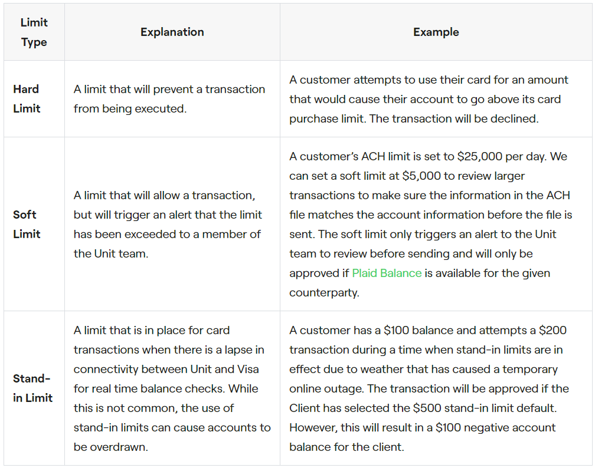
Stand-In Limits

Slide 29
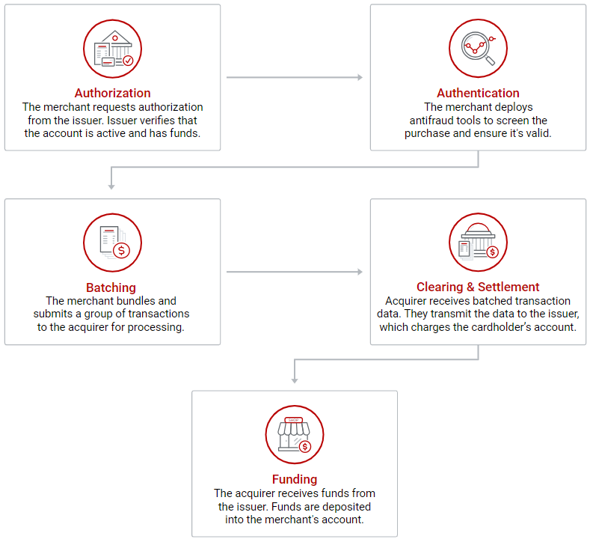
Credit Card Transaction Process

Slide 30

Stand In Parameters
Schemes provide the following options for Issuers to set-up, which are used by schemes to decision the authorization.
Transaction Parameters
Exception Files
PIN/EMV Checks
Issuers can define following transaction Parameters
Count of approved transaction for a given account / Day
Amount of approved transaction for a given account / Day
Single Transaction amount

Slide 31
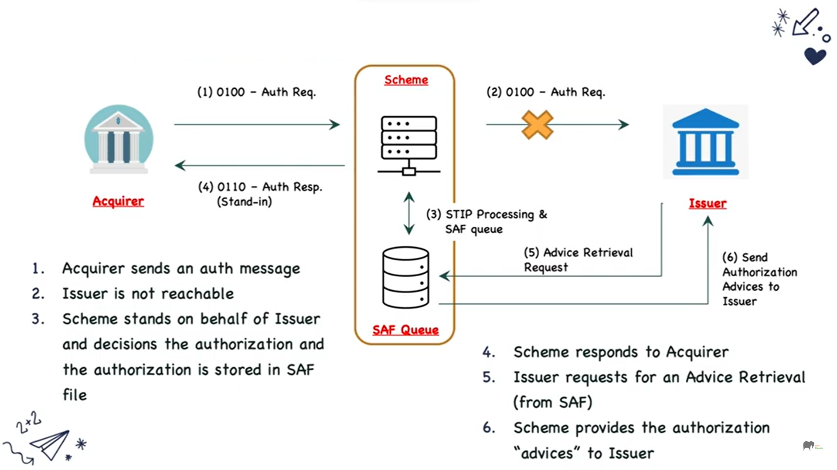
How Does It Work?

Slide 32
Partial STIP

Slide 33

Introduction To Partial STIP
A partial approval or authorization is the ability to partially authorize a transaction if the customer does not have the funds to cover the entire cost on their debit card, prepaid card or gift card.
The merchant can obtain the remainder of the purchase amount in another form of payment.

Slide 34
Card Whitelisting & Blacklisting

Slide 35
What is card whitelisting?
Whitelisting is a process of giving exception to a customer in Fraud Detection System (FDS) in order to relax the fraud filtering at customer's future card transactions.

Slide 36
What is card Hotlisting?
A "hotlisted card" typically refers to a credit or debit card that has been reported as lost or stolen and has been added to a "hotlist" by the card issuer or financial institution.
This means that the card will be denied for any further transactions in order to protect the cardholder's account from fraud or unauthorized use.

Slide 37
What is card BlackListing?
In payment, blacklisting is a fraud management method intended to protect against payment fraud. Many other methods, apart from blacklists, are used to protect data in online payment.
The goal of a blacklist is to detect fraudulent and high-risk customers to minimize payment loss or chargebacks.
How Does Blacklisting Work?
Blacklisting is performed primarily by fraud screening software. These monitor customer data through a variety of filters, such as region, IP address, credit card number and e-mail address.
Customers are automatically placed on the blacklist, intervening before the transaction is completed. In order to protect honest customers,
the system compares the aforementioned criteria with the data of a Blacklist customer.
If the comparison is positive, the transaction is rejected and other programs send the fraudulent details to the relevant cyber security authorities.

Slide 38
Types Of Card Blacklists
Internal blacklist
A blacklist can be administered internally by a company, for example, by a payment provider. This has the advantage of listing precisely the customers who have negatively affected the company and therefore offers a good overview.
External blacklist
Credit card companies such as Visa and MasterCard also use blacklists to identify buyers who have violated the rules of the company. The Member Alert to Control High-Risk (MATCH) also lists customers who were caught doing fraud or money laundering. Additionally, customers who provoked a noticeably high number of chargebacks or who were insolvent will be registered. Who is on the list is not determined by the credit card companies, but by the respective acquiring banks.

